Slide 1


Varsha Hindupur
26th January 2024

Slide 2

Outline
Executive Summary
Introduction
Methodology
Results
Conclusion
Appendix

Slide 3
Executive Summary
Space X Case Study allows us to analyze how Falcon 9 first stage lands successfully
Performed Data Wrangling and Exploratory Data Analysis (EDA)
Collected first-stage landing data by Web Scrapping Wikipedia
Visualized data to understand various launch-related factors
Utilized Machine Learning outcomes to identify if first-stage Falcon 9 will land successfully by hyper tuning the data
Logistic Regression
SVM (Support Vector Machine)
Decision Tree
K-Nearest Neighbours

Slide 4
Introduction
This Data Science project aims to delve into the operational successes of SpaceX, focusing on three primary aspects: First Stage landing, cost management, and time efficiency
The investigation into First Stage landings involves a detailed analysis of mission data, technological intricacies of Falcon 9 and Falcon Heavy rockets, and the underlying algorithms ensuring precise landings
On the cost management front, the project scrutinizes SpaceX's strategies for cost-effectiveness, including the utilization of reusable components, innovative manufacturing processes, and strategic procurement
Additionally, the study explores partnerships contributing to overall cost efficiency
Time efficiency is examined through an analysis of project management methodologies, scheduling strategies, and the use of automation and streamlined regulatory processes.
The ultimate goal is to provide Space Y with actionable insights to inform its mission goals and strategies

Slide 5

Section 1

Slide 6
Methodology
Executive Summary
Data collection methodology:
Data is collected from Space X api available at “https://api.spacexdata.com/v3”
Perform data wrangling
Data is processed, cleaned and landing outcomes are identified
Perform exploratory data analysis (EDA) using visualization and SQL
Perform interactive visual analytics using Folium and Plotly Dash
Perform predictive analysis using classification models
Different classification models – Logistic Regression, SVM (Support Vector Machine), Decision Tree, K Nearest Neighbours – models are used to predict landing outcomes. Furthermore, best hyperparameters are found as well as which model is performing better is judged by finding their accuracy score (percentage).

Slide 7
Data Collection
Stage 1:
Data is collected from API and information is collected via https://docs.spacexdata.com/
Rocket, Payloads, Launchpad and cores information is kept for further analyzing the data
Stage 2:
Falcon 9 historical launch records data is collected from a Wikipedia page containing HTML Tables by Webscrapping by using beautiful soup and requests libraries
Link: https://en.wikipedia.org/wiki/List_of_Falcon_9_and_Falcon_Heavy_launches

Slide 8
Data Collection – SpaceX API
Data Collection – all this data is collected in the form of an array
Github URL: https://github.com/varshahindupur09/SpaceX-Project/blob/main/1_jupyter-labs-spacex-data-collection-api.ipynb
FlightNumber
Date
BoosterVersion
PayloadMass
Orbit
LaunchSite Outcome
Flights
GridFins
Reused
Legs
LandingPad
Block
ReusedCount
Serial
Longitude
Latitude

Slide 9
Data Collection - Scraping
Web Scrapping: All information is collected and stored in dictionary called ‘Launch Dict’
GitHub URL: https://github.com/varshahindupur09/SpaceX-Project/blob/main/2_jupyter-labs-webscraping.ipynb
launch_dict['Flight No.'] = []
launch_dict['Launch site'] = []
launch_dict['Payload'] = []
launch_dict['Payload mass'] = []
launch_dict['Orbit'] = []
launch_dict['Customer'] = []
launch_dict['Launch outcome'] = []
launch_dict['Version Booster']=[]
launch_dict['Booster landing']=[]
launch_dict['Date']=[]
launch_dict['Time']=[]

Slide 10
Data Wrangling
GitHub URL:
https://github.com/varshahindupur09/SpaceX-Project/blob/main/3_labs-jupyter-spacex-Data%20wrangling.ipynb
The number of launches on each site is calculated:
CCAFS SLC 40 -→ 55
KSC LC 39A --→ 22
VAFB SLC 4E -→ 13
The number of Orbit occurrences is calculated
The number of each occurrence of mission outcomes is calculated
A ”Class” column is created to store the landing outcomes – success / failure

Slide 11
EDA with Data Visualization
GitHub URL:
https://github.com/varshahindupur09/SpaceX-Project/blob/main/4_jupyter-labs-eda-dataviz.ipynb
Plotted Graphs:
Flight Number v/s Payload Mass
Flight Number v/s Launch Site
Payload v/s Launch Site
Analyzing Success Rate of Each Orbit
Flight Number v/s Orbit Type
Payload v/s Orbit Type
Annual Trend for Launch Success

Slide 12
EDA with SQL
GitHub URL:
https://github.com/varshahindupur09/SpaceX-Project/blob/main/5_jupyter-labs-eda-sql-sqllite.ipynb
Executed:
Total Mass carried by boosters launched by NASA (CRS)
Average payload mass carried by booster version F9 v1.1
Date when the first successful landing outcome in the ground pad was achieved
And more…..

Slide 13
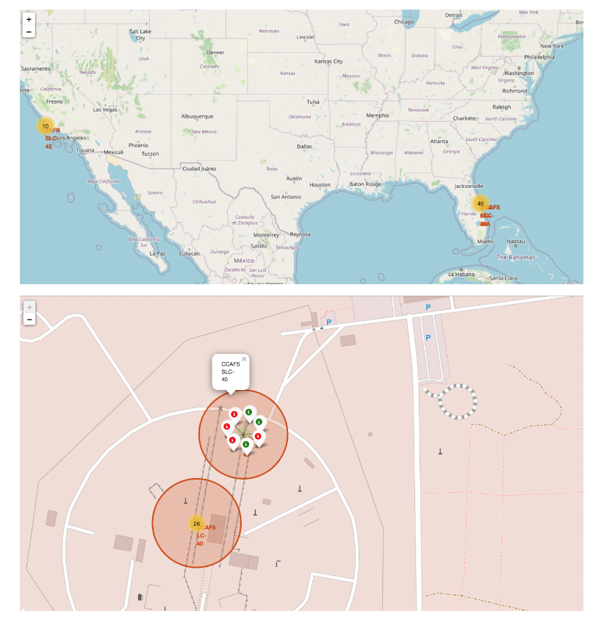
Build an Interactive Map with Folium
Github URL:
https://github.com/varshahindupur09/SpaceX-Project/blob/main/6_lab_jupyter_launch_site_location.ipynb

Slide 14
Build a Dashboard with Plotly Dash
Github: https://github.com/varshahindupur09/SpaceXProject/blob/main/6_lab_jupyter_launch_site_location.ipynb

Slide 15
Predictive Analysis (Classification)
Github:
https://github.com/varshahindupur09/SpaceX-Project/blob/main/7_SpaceX_Machine_Learning_Prediction_Part_5.jupyterlite.ipynb
* Accuracy of all models was 94% except decision tree which was 83%

Slide 16
Results
Exploratory data analysis results
Interactive analytics demo in screenshots
Predictive analysis results

Slide 17

Section 2

Slide 18
Launch Success Yearly Trend
Show a line chart of yearly average success rate
Show the screenshot of the scatter plot with explanations

Slide 19
Rank Landing Outcomes Between 2010-06-04 and 2017-03-20
Rank the count of landing outcomes (such as Failure (drone ship) or Success (ground pad)) between the date 2010-06-04 and 2017-03-20, in descending order
Present your query result with a short explanation here

Slide 20

Section 3

Slide 21
<Folium Map Screenshot 1>
Replace <Folium map screenshot 1> title with an appropriate title
Explore the generated folium map and make a proper screenshot to include all launch sites’ location markers on a global map
Explain the important elements and findings on the screenshot

Slide 22
<Folium Map Screenshot 2>
Replace <Folium map screenshot 2> title with an appropriate title
Explore the folium map and make a proper screenshot to show the color-labeled launch outcomes on the map
Explain the important elements and findings on the screenshot

Slide 23
<Folium Map Screenshot 3>
Replace <Folium map screenshot 3> title with an appropriate title
Explore the generated folium map and show the screenshot of a selected launch site to its proximities such as railway, highway, coastline, with distance calculated and displayed
Explain the important elements and findings on the screenshot

Slide 24

Section 4

Slide 25
<Dashboard Screenshot 1>
Replace <Dashboard screenshot 1> title with an appropriate title
Show the screenshot of launch success count for all sites, in a piechart
Explain the important elements and findings on the screenshot

Slide 26
<Dashboard Screenshot 2>
Replace <Dashboard screenshot 2> title with an appropriate title
Show the screenshot of the piechart for the launch site with highest launch success ratio
Explain the important elements and findings on the screenshot

Slide 27

Section 5

Slide 28


